Slide 1
Design & development of Autonomous Farming With Plant health Indication System
BY

Slide 2
Description
Nearly three quarters of Indian families depend on agricultural income.
Almost all crops suffer from plant diseases and insects like Tungro virus, moths and butterflies.
Farmers find it difficult to identify actual disease.
According to Indian crop survey, on an average scale of 80 percent of crops get damaged due to disease and insects.
If the problems are known before then diseases can be prevented.
There is a scope for improvement in these fields using IoT Technology. So,
We are designing an IoT based robot that will monitor the crop and also the environment around the crop.
This system uses machine learning technique to identify the problem and takes measures to prevent diseases and insects that harm the crops.

Slide 3
Description
Different sensors are used to study the environment, and a camera to detect the plant type and disease.
A number of prototype guidance systems have been developed but have not yet proceeded to commercialization.
Our crop monitoring system is efficient and affordable which will help the Indian farmers.

Slide 4
Introduction
Agriculture is a major occupation in India. Some of the major problems in the Indian agriculture are, rising of input costs, lack of skilled labours, scarcity of water resources and crop monitoring.
To overcome these problems, the automation technology was used in agriculture.
The automation in agriculture could help farmers to reduce their efforts. The IoT plays a vital role in various fields such as industrial, medical, automobiles etc., The IoT technology is gradually increasing its productivity in agricultural field.
The IoT technology is being developed for irrigation system, soil health monitoring, environment monitoring, etc., All of these functions have not yet performed using a single IoT platform.

Slide 5
Problem statement
Causes of Crop Failure
Adverse Climatic Conditions
Adverse climatic conditions will most probably top the list of the causes of crop failure.
Adverse weather conditions include conditions that are too harsh for crops to survive, including extremely cold or extremely hot temperatures.
These adverse weather conditions cause the crops to either dry up due to the scorching sun or fail to grow due to extremely cold conditions.
Unpredictable Weather Conditions
In the recent past, the climatic and weather conditions have been quite unpredictable.
The sequence of the cultivation seasons has been interrupted by the constant change in weather conditions.
For instance, an extended period of drought, prolonged wet season, flash floods, and a complete change of season.
The unpredictable weather conditions are a result of global warming and other human activities.
Pests and Diseases
Several pests affect the growth of crops in the fields. Some of these pests tend to be expensive to curb.

Slide 6
For instance, most farmers in the developing world will watch their crops being consumed by pests such as armyworms, stalk borer, Black cutworm, and Asiatic Garden beetles simply because they do not have money to purchase pesticides. Several diseases also lead to crop failure.
Some of these diseases include leaf blight, Pythium, and southern rust. Pests and diseases, if not detected and dealt with early enough, may lead to massive crop failure.
Poor Farming Practices
Poor farming methods and techniques will also lead to crop failure. The poor farming methods are mostly as a result of lack of knowledge of modern farming techniques and lack of funds to embrace the technology in farming.
The farming methods that could lead to crop failure include mono-cropping and failure to apply fertilizers and pesticides.
Application and practice of the new and the superior farming methods go a long way in curbing and reducing crop failure.
Human Activities
Several human activities affect the prosperity of crops in the fields.
The application of harsh chemicals could lead to the wilting of the crops. Other activities that could lead to crop failures include poor disposal of industrial waste products which may increase levels of greenhouse gases in the atmosphere.
The effects of these gases, such as sulfur dioxide, lead to the fall of acid rain and blockage of leaf pores. These phenomena lead to crop wilting and the result is crop failure.

Slide 7
Objective
Our project is concerned with the farmer and the cultivation land.
It uses a camera and all the sensors which are used to monitor the agricultural land.
It can be used from the plantation period to harvesting period.
It detects plant type and calculates the area of the field itself.
The robot monitors the field, checks the soil health based on moisture level and Ph level.
The plant health is judged based on its leaf color.
The robot prompts farmer, if any problem associated with the field is found in local language.

Slide 8
Scope of Project
This Project will prompt further headway in field of farming.
By decreasing human efforts in unfavorable climatic conditions, the plants well being will lie in safe hands.
This project will open entryways to another mechanical progression in observation and will at last prompt advancement in agriculture field.

Slide 9
Methodology
The agricultural robot will be using a chassis as a base to connect and assemble everything on it, will be consisting of four motors. Two of which are high torque motors and the rest being gear motors. The robot is capable of doing four separate functions.
1. Crop monitoring
2. Soil fertility check
3. Irrigation System
4. Environment monitoring
These functions will be working in different modes. Programming of different modes is done separately.
The sharp sensor gives input to the robot by measuring the length and breadth of the field.
Arduino is programmed in such a way that, after getting the data of length and breadth of field, mode will be selected in which the robot is made to work.

Slide 10
Mode 1. Detect the plant type: This mode checks the plant type by its leaf size and pattern using machine learning technique. There on deciding the plant type, we are going to check other conditions based on plant type.
Mode 2. Detect plant and soil health: When we know the plant type, we can check the condition of the plant in accordance of it’s need. Some crop needs more nutrients in soil where as some crop needs less and color of some deficiency shown on the plant leaf may vary in color and visibility.
Mode 3. Detect the Moister level of the soil: The moister level for all the crops is not same. Some may need more moister level where as some need less moister level. So, we have an effective irrigation system, where it will be working on accordance with plant’s need.
Mode 4. Checking the Environment condition: Every crop need its own likely environment where it will grow faster and yields more. So, when we check the environment, we come to know that the crop yield more or not. If not, we can take some precautions.

Slide 11
To check the fertility of the soil we are going to use the soil moister sensor and Ph sensor.
Based on the output of these two sensors and the color of the crop leaves, we can decide the fertility of the soil and the health of the plant.
The Ph sensor can decide on soil nature and moister level where as the color of leaf can tell us about the fertility of the soil and its health.

Slide 12
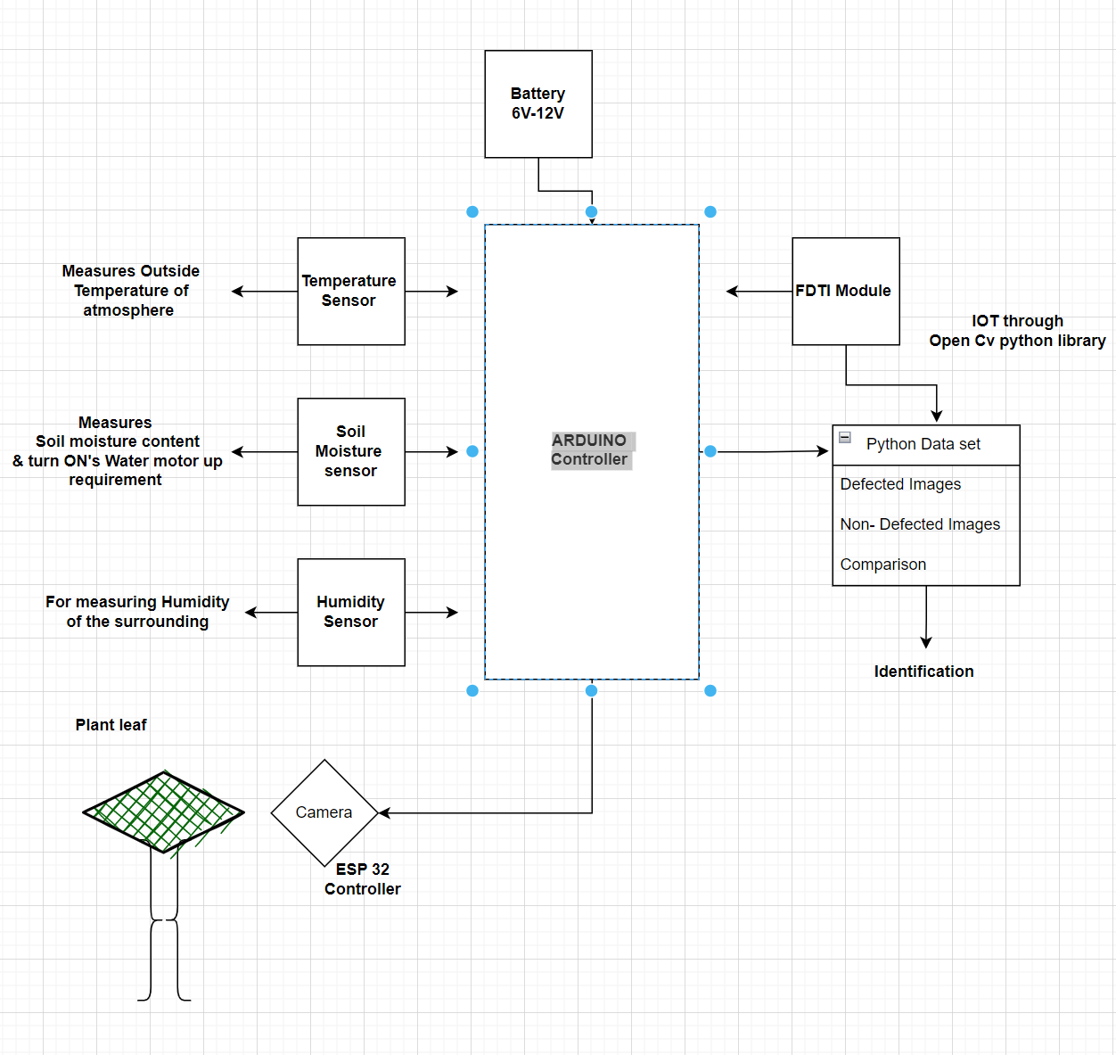
Schematic Diagram

Slide 13
Construction of the project
Esp 32 is Controller which can be used for monitoring of a specific object or body, it comes with an inbuilt Camera & wi-fi Module. Camera screening can be done via Serial monitoring by connecting to a server port.
The project comes with a humidity, moisture & temperature sensor.
These sensors measures the surrounding atmosphere and operates according to collaboratives. Like example,
If the temperature of surrounding is high it turns on the fan to maintain the constant temperature to efficiently grow the plantation. Or
It providers spraying of water according to humidity or moisture of the soil or atmosphere condition by turning on the water motor upon the requirement using Motor drivers provided.
Motor drivers are used to control the actuation of Motor ONN & OFF for a particular temperature, humidity & moisture of the soil.

Slide 14
Form Images processing and defect identification
Data set will be prepared with defective and non-defective Images by creating identical folders for each defect, when the camera module captures the Image of leaf, data from the code will be compiled with real time image and identification will done on the basis of defect present on the leaf. Further this action will be solved by spraying the fertilizer for the defected leaf.

Slide 15
Note
We can set the operations of spraying and switching ONN or OFF of the fan with an empirical value of surrounding.
Example : - if the temperature of the atmosphere reaches more then 45 degrees then the Motor of blower or fan is turned ONN when the temperature comes below 30 degrees automatic cut-off of motor will be coded in the controller.
Water spraying also works same as above, depending up on the moisture os the soil or surrounding etc.
It also has a camera to monitoring system to observe the plantation from bacterial affection.
We can either spray water or fertilizer depending up on the requirement.

Slide 16
Features & Future Scope
Features
1. Fully programmed framework so decreases the human work.
2. Saves time.
3. A ton of precision. Harvesting, weeding.
Future Scope
We can build robots exactness of identification of leaf shading effectively by utilizing high quality camera.
Wire-less System. We can make this framework remote by utilizing RF connectors.
The framework can additionally altered for picking organic products, and real cutting procedure by the framework.

Slide 17
Components
LDR sensor
Soil Moisture
Temperature Sensors
DC Motor
Rotating mini Blower or fan
Camera Module Esp 32 with inbuilt Wi-fi.
Fan or blower
All the data are screened on Android mobile or serial monitor Apps in the PC . Like health wise.

Slide 18
Literature Review
SL No | Author | Journals | Title
1. | Dhanasekar J, 2 Sengottuvel P, 3N Srikanth | International Journal of Pure and Applied Mathematics Volume 116 No. 20 2017, 457-461 ISSN: 1311-8080 (printed version); ISSN: 1314-3395 | AUTONOMOUS FARMING ROBOT WITH PLANT HEALTH INDICATION
2. | Madan Veer, Akash Chavan, Tushar Chavan | International Journal of Computer Applications (0975 – 8887) National Conference on Advancements in Computer & Information Technology (NCACIT-2016) | Autonomous Farming Robot for Plant Health Indication
3. | Bhure Amit P 2 , Mangnale Shivkumar 3 Pandharkar Suraj R | International Journal of Advanced Technology in Engineering and Science www.ijates.com Volume No.03, Issue No. 01, January 2015 | AUTONOMOUS FARMING ROBOT WITH PLANT HEALTH INDICATION
4. | Nitin Gawade2 , Sharvari shedge3 , Amol padale | INTERNATIONAL JOURNAL OF INNOVATIVE RESEARCH IN ELECTRICAL, ELECTRONICS, INSTRUMENTATION AND CONTROL ENGINEERING Vol. 4, Issue 4, April 2016 | Autonomous Farming Robot for Plant Health Indication Using Image Processing

Slide 19
Paper 1
Agribusiness is extremely work concentrated field and just field where the robot is not utilized by and by.
Presently a-days numerous ventures are attempting to diminish this human work by making machine in terms of robot.
Vision based line direction of robot is finished by a strategy named as posture (having mix of picture and Its edge) directs a robot in succession field.
So along these lines the stage which we have executed causes the robot to utilize system named as stance for its column direction.
Here we are outlining independent savvy cultivating robot which shows the plant well being by watching the shade of their leaves as far as picture preparing which is finished by raspberry pi and some confinement to plant structure.
The robot additionally takes note of the encompassing natural states of the plant as far as temperature and stickiness with the goal that the robot will choose about wellbeing of plat and will show on the LCD.

Slide 20
Paper 2
Agriculture is very labour intensive field and only field where the robot is not used presently.
Now-a- days many industries are trying to reduce this human labor by making machine in terms of robot. Vision based row guidance of robot is done by a technique named as pose (having combination of image and its angle) helps to guide a robot in a row field.
So thus the platform which we have implemented helps the robot to use technique named as pose for its row guidance.
Here we are designing autonomous intelligent farming robot which indicates the plant health by observing the colour of their leaves in terms of image processing which is done by raspberry pi and some limitation to plant height.
The robot also notes the surrounding environmental conditions of the plant in terms of temperature and humidity so that the robot will decide about health of plat and will display on the LCD.

Slide 21
Paper 3
Agriculture is very labor intensive field and only field where the robots are not involved.
Now-a- days many industries are trying to reduce this human labor by making robots and machines. A vision-based row guidance method is presented to guide a robot platform which is designed independently to drive through the row crops in a field according to the design concept of open architecture.
Then, the offset and heading angle of the robot platform are detected in real time to guide the platform on the basis of recognition of a crop row using machine vision.
And the control scheme of the platform is proposed to carry out row guidance. Here we are designing a autonomous intelligent farming robot which indicates the plant health by observing the color of their leaves and based on the height of the plant.
The robot also notes the surrounding environmental conditions of the plant like temperature, moisture and humidity so that the robot will decide about health of plat and will display on the LCD.
The robot has also watering mechanism it will water the plants according to their needs by observing soil moisture and humidity.
It will also tell when the cutting process should take place by observing the leaf color.

Slide 22
Paper 4
In the proposed system, the application facilitates user to provide the image of the leaf as the input.
The system applies algorithm to derive vital parameters related to the properties of the leaf.
It then compares these parameters with the ones stored against a leaf entry in the database.
On successful match of the parameters, the application displays information related to that particular leaf to the user for his review.
The images of the plant leaf are captured through the camera. This image is in RGB (Red, Green And Blue) form. Color transformation structure for the RGB leaf image is created, and then, a for the color transformation structure is applied to a device-independent colour space transformation.

Slide 23
Literature Gap Identified
We had researched many of the journals most of the projects are on simple monitoring system based on Image aqua-station using raspberry pie controller.
The main disadvantage is controller cost Raspberry comes with price of 9000-11000 per piece.
In our project we are trying to develop the setup with minimum cost so that each & every farmer can make use of this.
ESP 32 Controller Comes with 750/- cost these in turn reduces thousands of cost to the framers.

Slide 24
Components required
LDR sensor
Soil Moisture
Temperature Sensors & Humidifier senor
Camera Module Esp 32 with inbuilt Wi-fi.
Fan or blower
Arduino.
L293d Motor Driver
All the data are screened on Android mobile or serial monitor Apps in the PC . Like health wise.

Slide 25
Data preparation
Preparing the image data and segmentation masks
Now we need to prepare the image data and the corresponding segmentation mask for each image.
We have the images divided into twelve folders. In this section images with defective parts are stored.
The first image represents a defective product and the second one represents a non-defective image.
Now we need to prepare the segmentation maps for these images.
The segmentation map should detect the defective parts in the image. For the above images, the expected segmentation maps will be like this.
The data for defected part is obtained using the get_data function which will be designed later in the part.
one can use this information and draw an segmentation mask using the skimage function, which will also be done in later process.

Slide 26
ESP 32 Connection for Open cv
API Concepts
Automatic Memory Management
Automatic Allocation of the Output Data
Saturation Arithmetic’s
Fixed Pixel Types. Limited Use of Templates
Input Array and Output Array
Error Handling
Finally,
Multi-threading and Re-enter ability

Slide 27
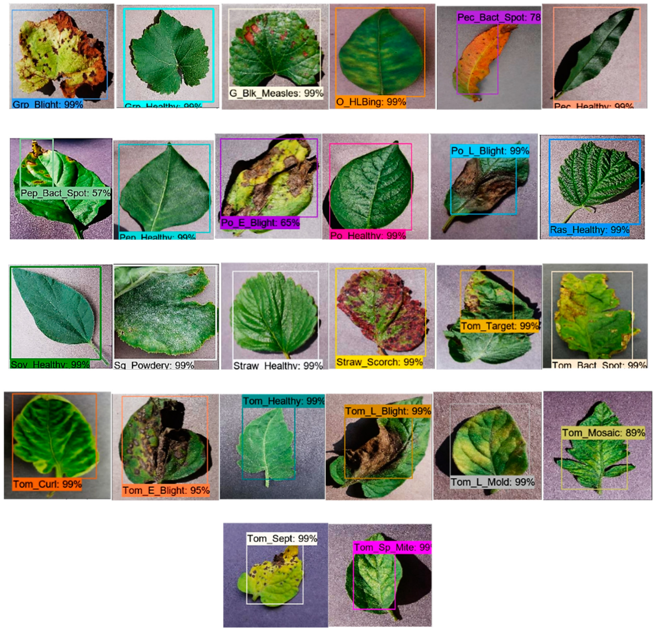
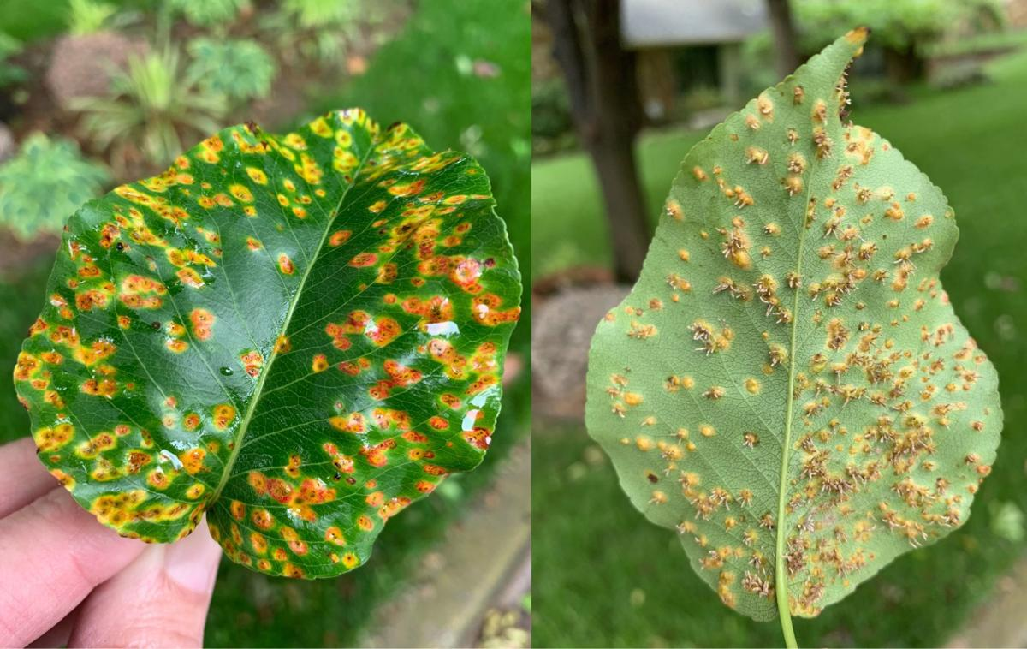
Defected images of leaf for data set

Slide 28
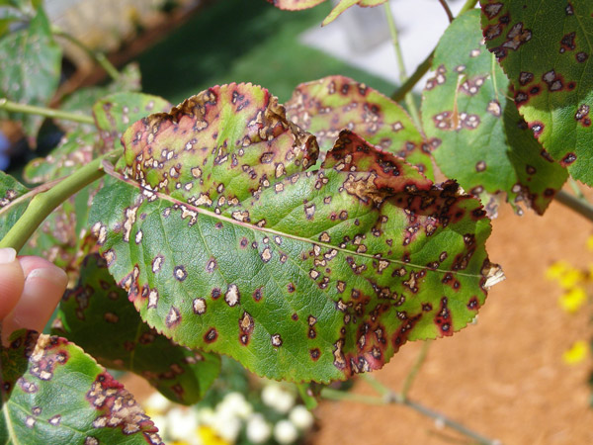
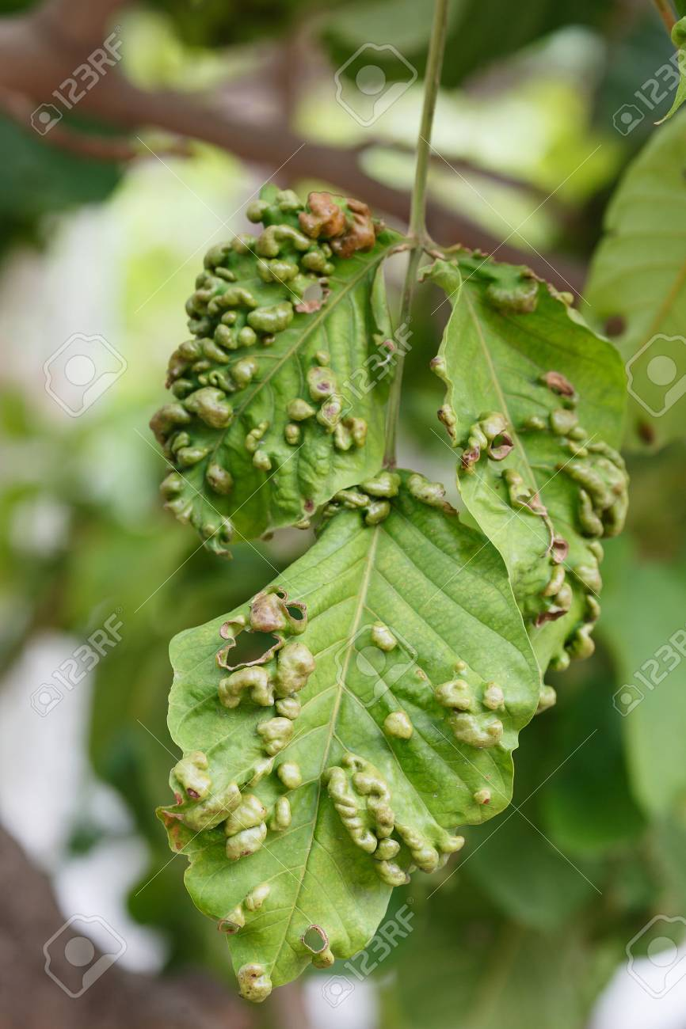
Defected images

Slide 29
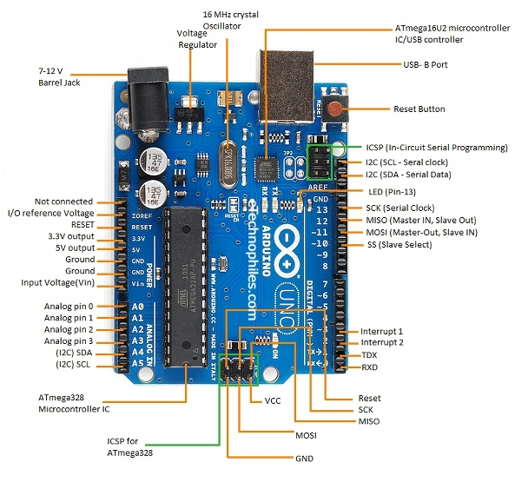
Board | Name | Arduino UNO R3
 | SKU | A000066
Microcontroller | ATmega328P
USB connector | USB-B
Pins | Built-in LED Pin | 13
 | Digital I/O Pins | 14
 | Analog input pins | 6
 | PWM pins | 6
Communication | UART | Yes
 | I2C | Yes
 | SPI | Yes
Power | I/O Voltage | 5V
 | Input voltage (nominal) | 7-12V
 | DC Current per I/O Pin | 20 mA
 | Power Supply Connector | Barrel Plug
Memory | ATmega328P | 2KB SRAM, 32KB FLASH, 1KB EEPROM

Slide 30
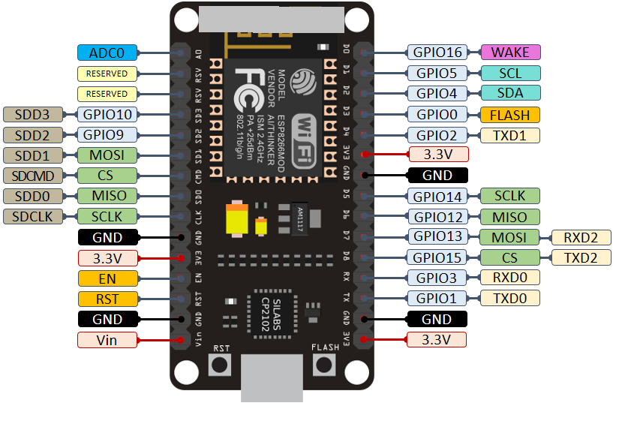
The Arduino IoT Cloud is a online platform that makes it easy for you to create, deploy and monitor IoT projects.
ESP32 / ESP8266 is used for IOT to create , Deploy & monitoring of Battery
The Arduino IoT Cloud supports a wide range of third party boards based on the ESP32 and ESP8266 microcontrollers with support for Wi-Fi. To set them up, simply choose the third party option in the device setup.
Connecting ESP32 & ESP8266 to Arduino Cloud IoT
The goals of this project are:
Send data to the cloud from the board.
Turn ON/OFF an motor fan on the board through the cloud when Maximum temperature is induced in the battery.
We will also need the following components for the circuit:
LED
220 ohm resistor
Breadboard
Jumper Wires

Slide 31
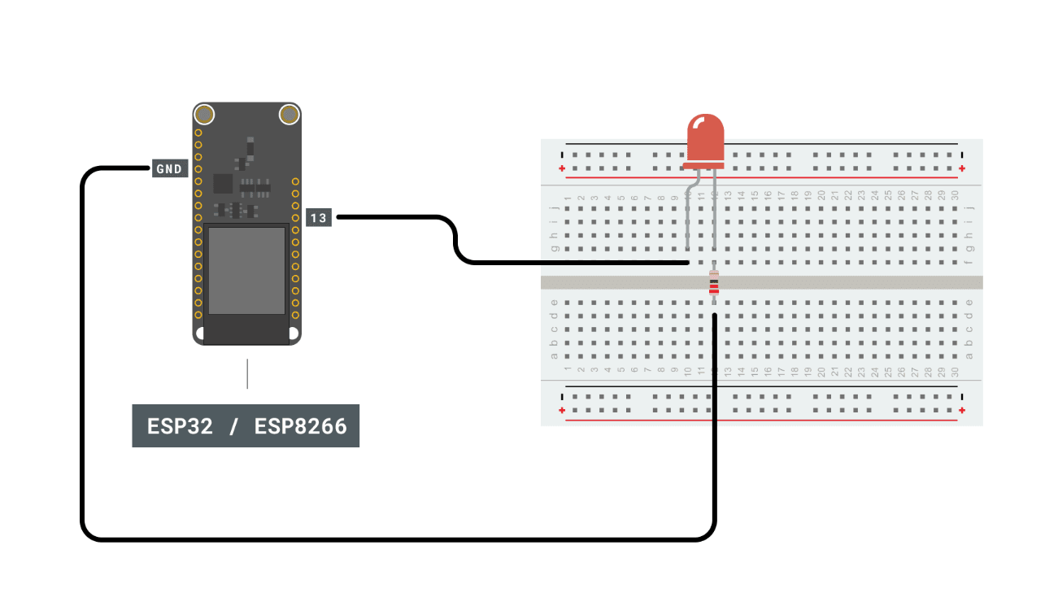
Circuit connection of Board to ESP 32 for Cloud Interaction IDE design
Step 1: Setting up the device
1. Once in the cloud, click on the "Devices" tab. Then, click on the "Add device" button.
2. Then, click on "Set up a 3rd party device".
3. Now we need to select what board we are using. Select either ESP32 or ESP8266, and then choose the board from the drop-down menu.
4. Now the board needs a name. We choose My_ESP32, but you can have a lot more imagination than that!
5. You will now receive your Device ID and Secret key. Please note that the secret key cannot be recovered, so make sure you note it down. You can also download a PDF with the information.
When you have saved it, tick the box at the bottom, and click on "Continue".
You have now configured your ESP32 board with the Arduino Cloud IoT. Your device will now appear in the list of devices.

Slide 32
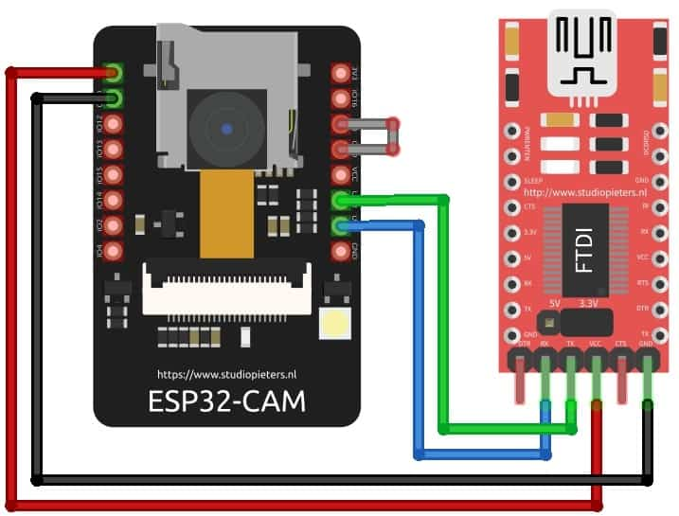
ESP32-CAM FTDI Connection
For programming the board, you need any USB-to-TTL Converter Module or an FTDI Module. There are so many FTDI Module available based on CP2102 or CP2104 Chip or any other chip.
For getting started with ESP32 CAM Module, make a following connection between FTDI Module and ESP32 CAM module.
ESP32-CAM | FTDI PROGRAMMER
GND | GND
5V | VCC (5V)
U0R | TX
U0T | RX
GPIO 0 | GND

Slide 33
Step 2: Creating a Thing
The next step is to create a Thing. This is done by navigating to the "Things" tab.
Then, we need to create a new Thing, by clicking on the "Create Thing" button. We can then rename our Thing something appropriate to what we are doing, in this case we simply chose ESP32 Project. Now, we need to link our device with our Thing. This is done by clicking on the button in the "Device" section. This will open a window, where your ESP32 / ESP8266 should be available to select.
Once the device is linked, we need to create two variables: random_value and led_switch. Click on "Add variable" button. This will open a window where you need to fill in variable information. Let's create the random_value first. The data type is int, permission is read only and update policy is on change. Once done, click on the "Add variable" button.
Now, let's also add the led switch variable. The data type for this variable is Boolean, the permission is read & write, and update policy is on change. Once done, click on the "Add variable" button.

Slide 34
Step 3: Adding credentials
Now, we need to enter the credentials for our network, plus the secret key generated during the device configuration.
First, click on the button in the "Network Section".
Then, enter the credentials (network name, network password and secret key). Click "Save" when finished.
The next step is to program the board. To do so, we need to go to the "Sketch" tab.
Programming the board includes Data set as follows
Voltage or current value, if there is deflection in the value then the board receives the signal via sensor and necessary action will be taken via cloud code program like power cut-off from the battery.
Temperature value, if the temperature of the battery exceed or deceased then the cooling fan will be turned ON/OFF upon situation.
Gas value, if the battery gets over heated then the battery releases hazardous gases which permanently damages the battery if it is turned off at proper time. Then there will be buzzer indication via cloud.

Slide 35
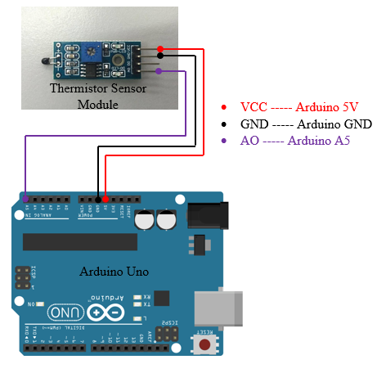
6. NTC Thermistor Temperature Sensor Module & IDE design
It is very sensitive to ambient temperature. It is generally used to detect the temperature of the surrounding environment.
Through potentiometer adjustment, it is possible to change the temperature detection threshold. DO output can be directly connected to the micro controller to detect high and low, by detecting temperature changes in the environment.
Working voltage: 3.3V-5V
Output form: DO digital switching outputs (0 and 1) and AO analog voltage output
Fixed bolt hole for easy installation
Small PCB board size: 3.2cm x 1.4cm
uses a wide voltage comparator LM393

Slide 36
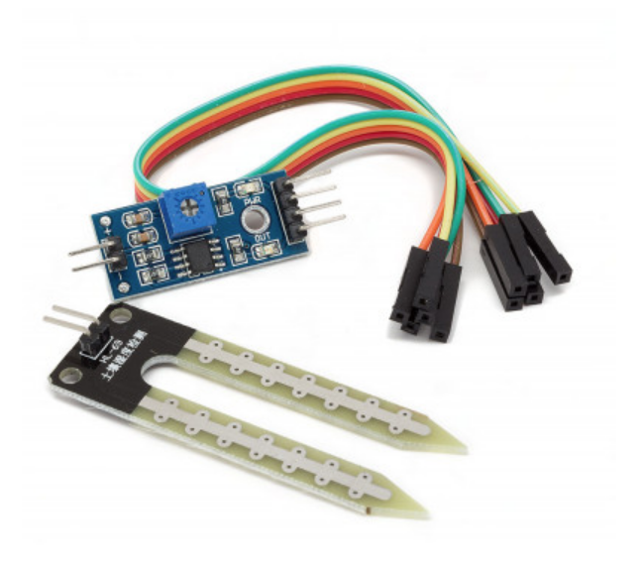
Soil Moisture Sensor Module
This is an easy to use digital soil moisture sensor. Just insert the sensor in the soil and it can can measure moisture or water level content in it. It gives a digital output of 5V when moisture level is high and 0V when the moisture level is low in the soil.
Specifications:-
Operating voltage: 3.3V~5V
Dual output mode,analog output more accurate
A fixed bolt hole for easy installation
With power indicator (red) and digital switching output indicator (green)
Having LM393 comparator chip, stable
Panel PCB Dimension: Approx.3cm x 1.5cm
Soil Probe Dimension: Approx. 6cm x 3cm
Cable Length: Approx.21cm
VCC: 3.3V-5V
GND: GND
DO: digital output interface(0 and 1)
AO: analog output interface

Slide 37
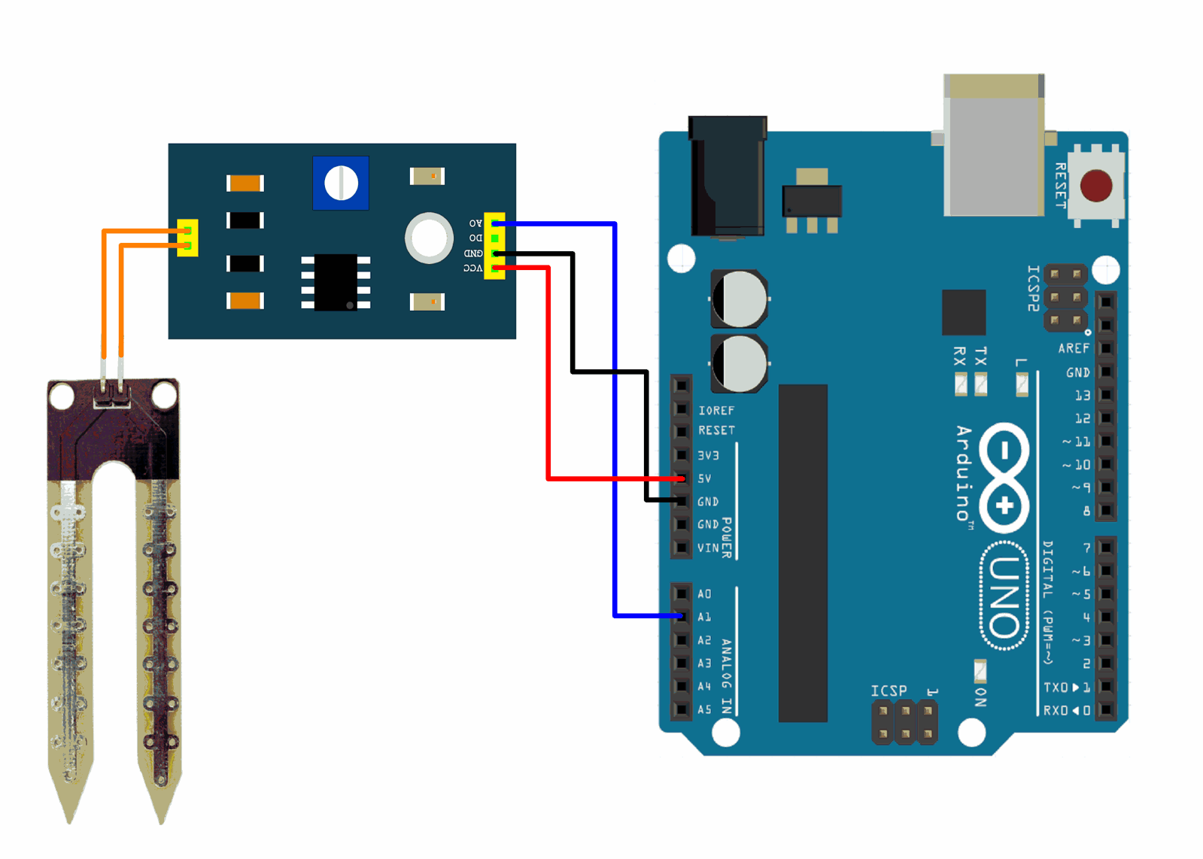
Pin connection of sensor

Slide 38
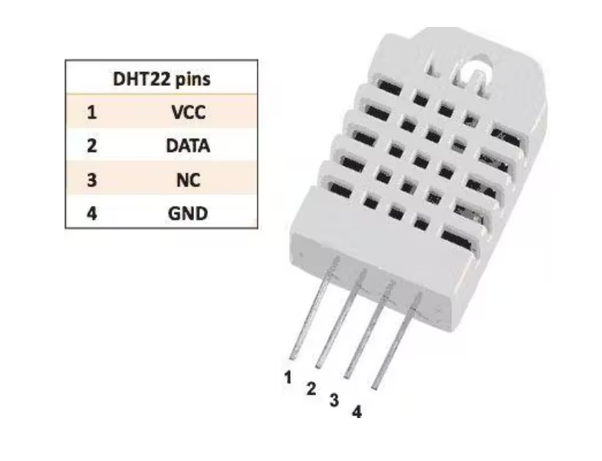
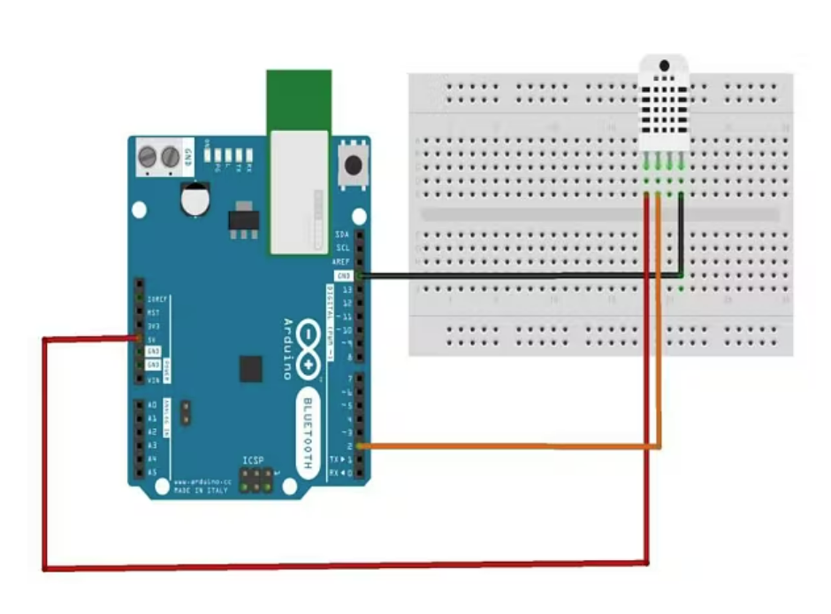
Humidity Sensor (DHT22)
The DHT-22 (also named as AM2302) is a digital-output, relative humidity, and temperature sensor. It uses a capacitive humidity sensor and a thermistor to measure the surrounding air, and sends a digital signal on the data pin.
Technical Details
Power − 3-5V
Max Current − 2.5mA
Humidity − 0-100%, 2-5% accuracy
Temperature − 40 to 80°C, ±0.5°C accuracy

Slide 39
Installing ESP32CAM Library
Here we will not use the general ESP webserver example rather another streaming process. Therefore, we need to add another ESPCAM library. The esp32cam library provides an object-oriented API to use OV2640 camera on ESP32 microcontroller. It is a wrapper of esp32-camera library.
Once downloaded add this zip library to Arduino Libray Folder. To do so follow the following steps:
Open Arduino -> Sketch -> Include Library -> Add .ZIP Library… -> Navigate to downloaded zip file -> add

Slide 40
Source Code/Program for ESP32 CAM Module
Here is a source code for Object Detection & Identification with ESP32 Camera & OpenCV.
Write the code according to compiler and execute the program
Before Uploading the code you have to make a small change to the code. Change the SSID and password variable and in accordance with your WiFi network.
Now compile and upload it to the ESP32 CAM Board. But during uploading, you have to follow few steps every time.
Make sure the IO0 pin is shorted with the ground when you have pressed the upload button.
If you see the dots and dashes while uploading press the reset button immediately
Once the code is uploaded, remove the I01 pin shorting with Ground and press the reset button once again.
If the output is the Serial monitor is still not there then press the reset button again.

Slide 41
Python Library Installation
For the live stream of video to be visible on our computer we need to write a Python script that will enable us to retrieve the frames of the video.
Open Python
Then Go to the command prompt and install NumPy, OpenCV and cvlib libraries.
type: pip install numpy and press enter. After the installation is done.
type: pip install opencv-python and press enter.
type: pip install cvlib and press enter, close the command prompt.
In our python code we have used urllib.request to retrieve the frames from the URL and the library for image processing is OpenCV. For Object detection, we have used the Cvlib library that uses an AI model for detecting objects. Since the whole process requires a good amount of processing power, thus we have used multiprocessing which utilizes multiple cores of our CPU. Refere openCv python liberies details

Slide 42
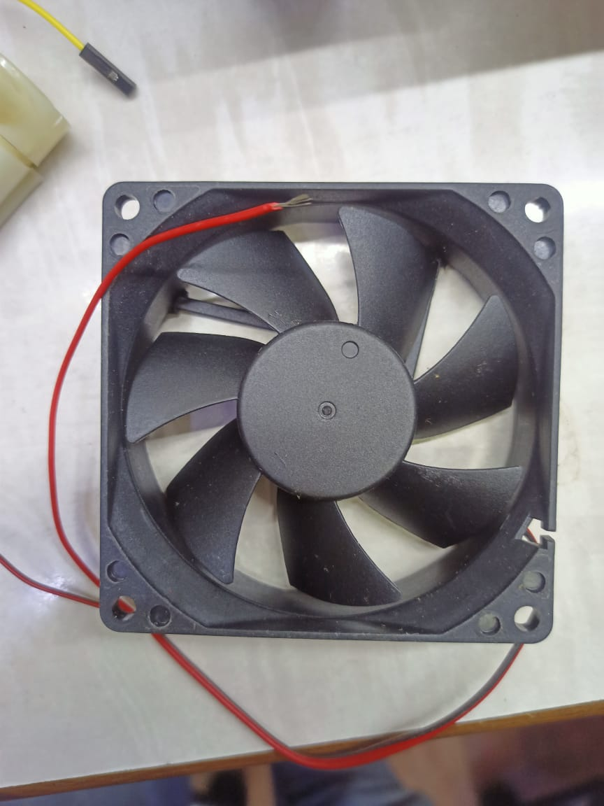
Hardware purchase
MINI 5v DC FAN 40MM X 40MM X 10MM (4010): Brushless Cooling Fan
Specification
Size: (40 x 40 x 10mm)
DC: 5V 0.14A.
Speed: High Speed
Blades : 7 blade cooling fan.
Very low noise
Material: hard plastic.

Slide 43
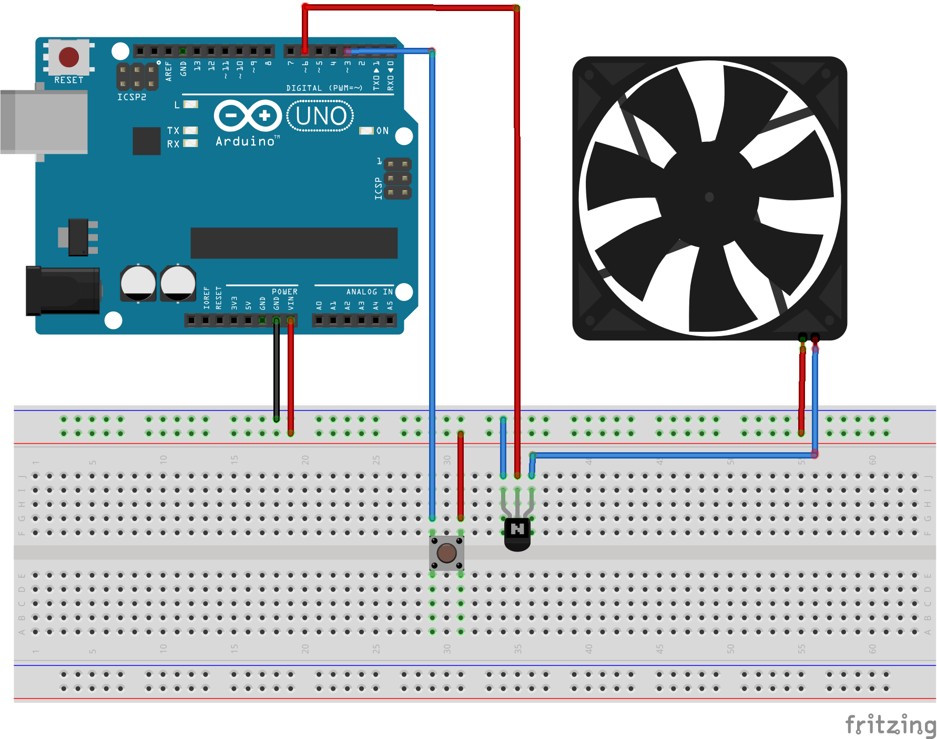
Pin diagram of fan to Arduino

Slide 44
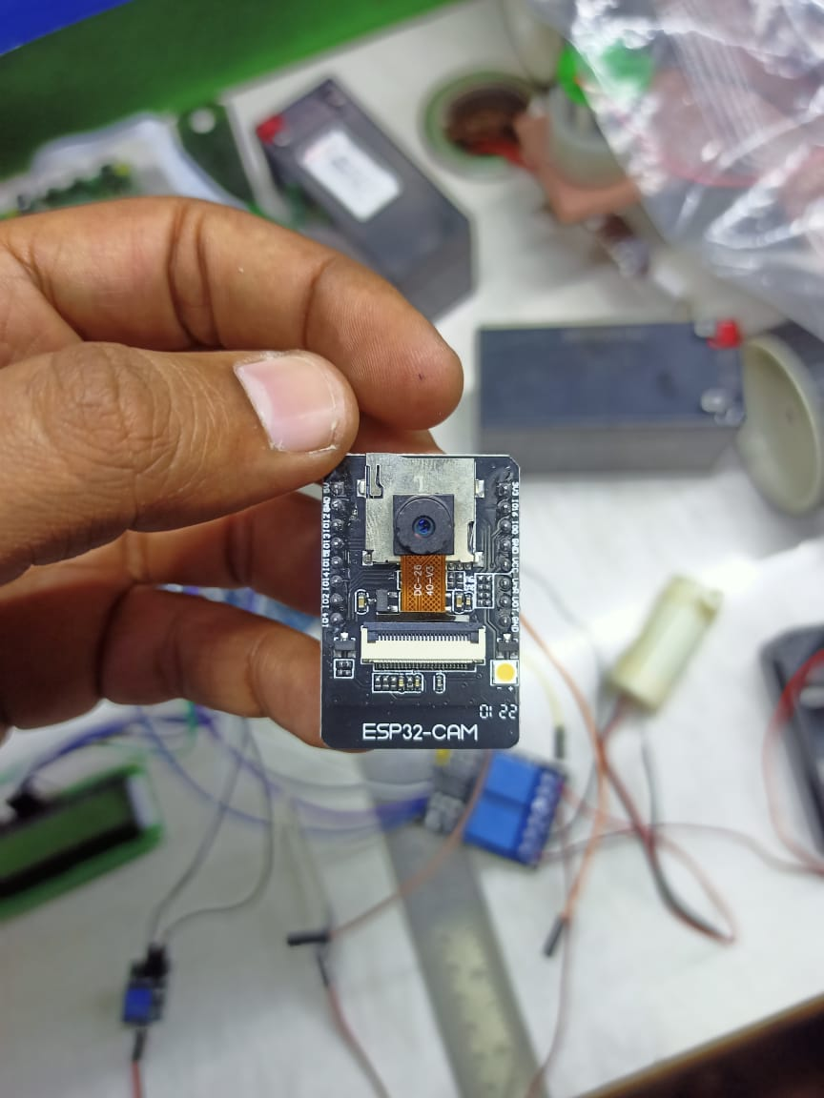
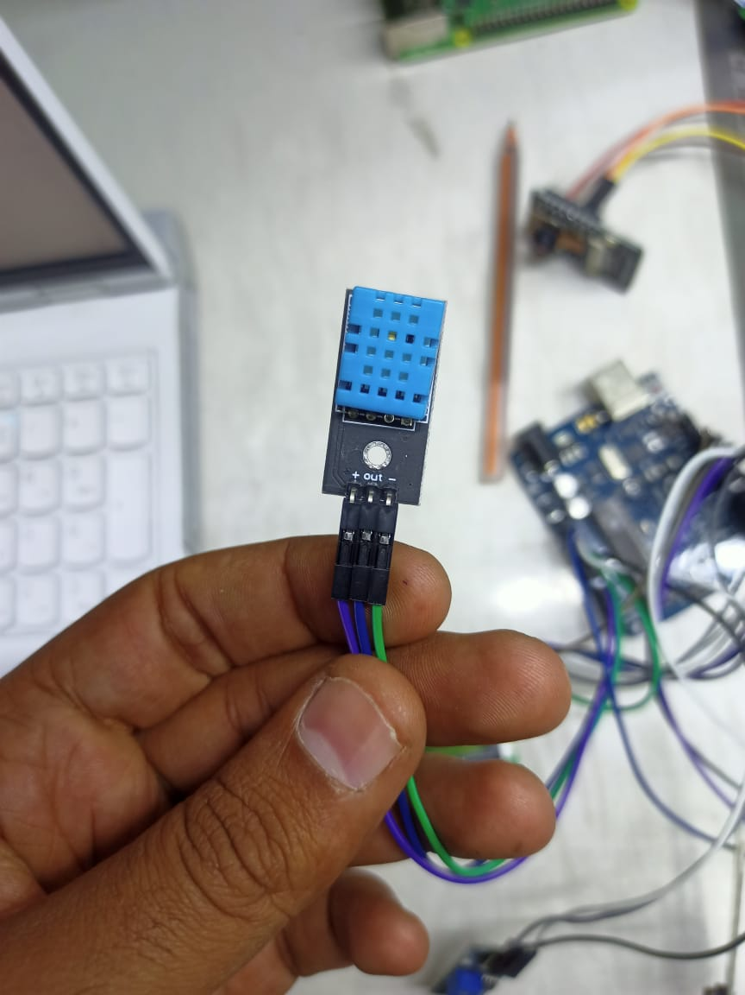
ESP 32 Cam + inbuilt wi-fi module with temperature & humidity sensor

Slide 45
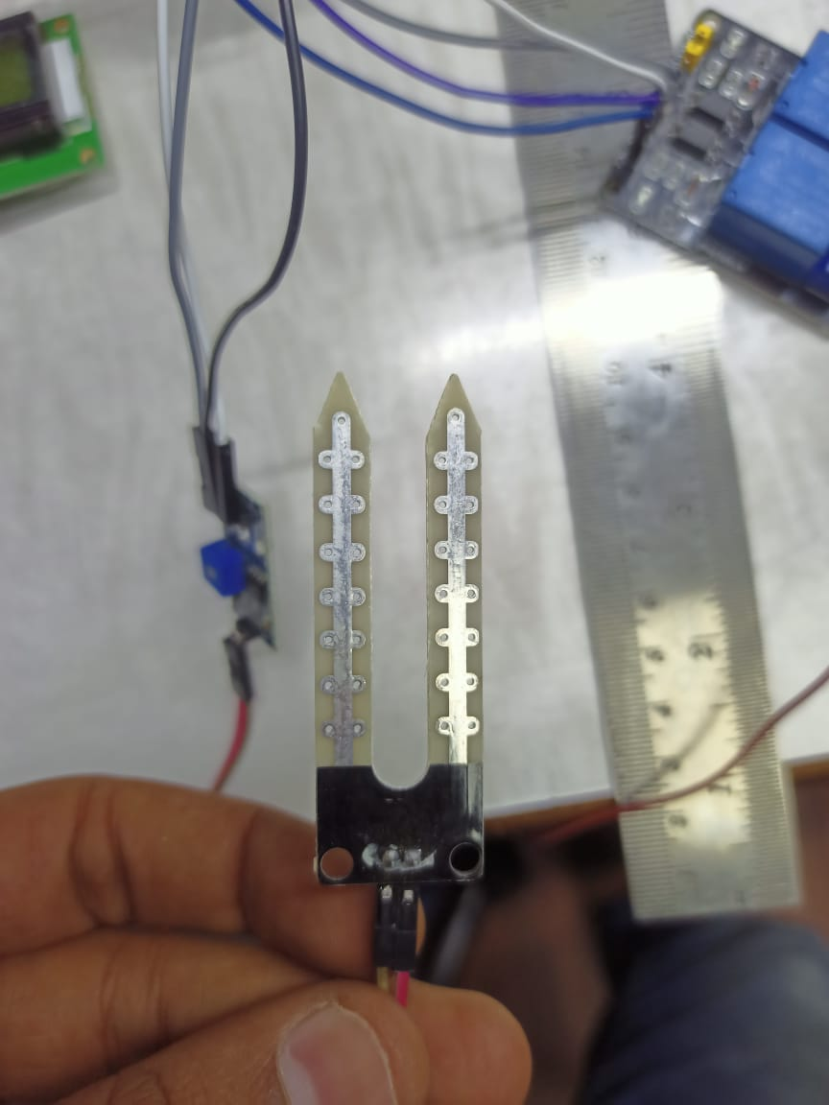
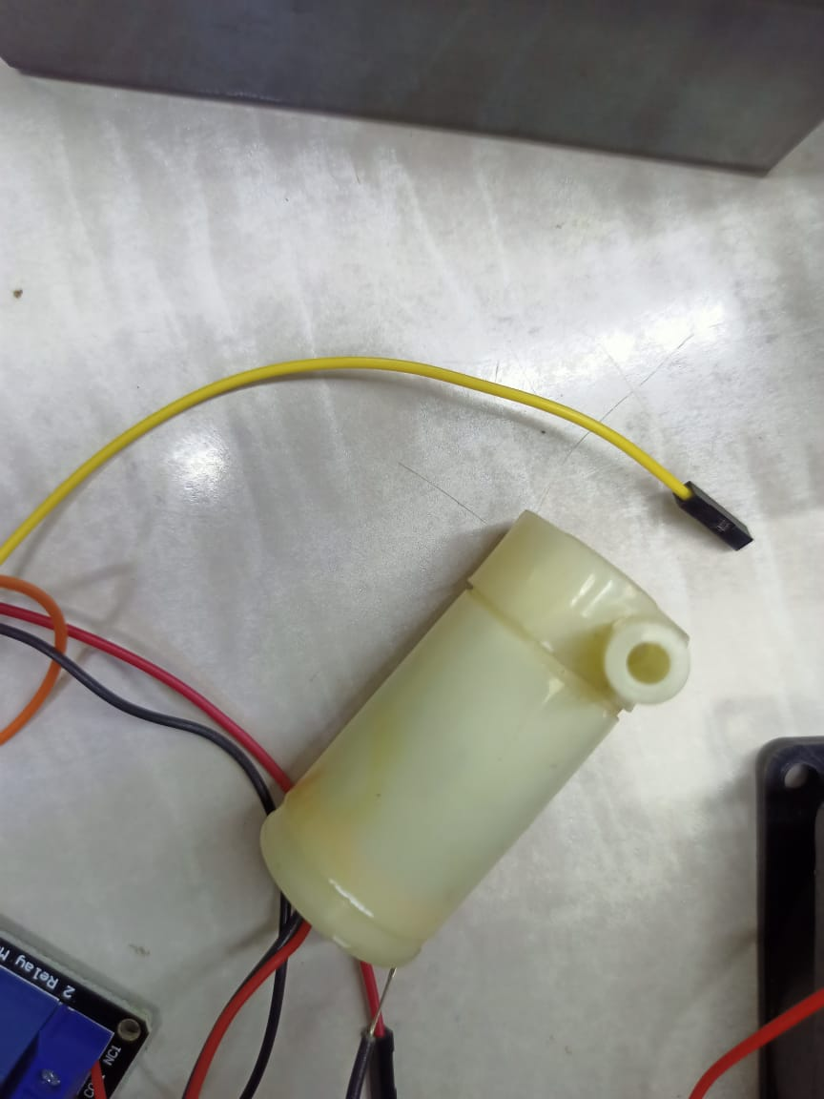
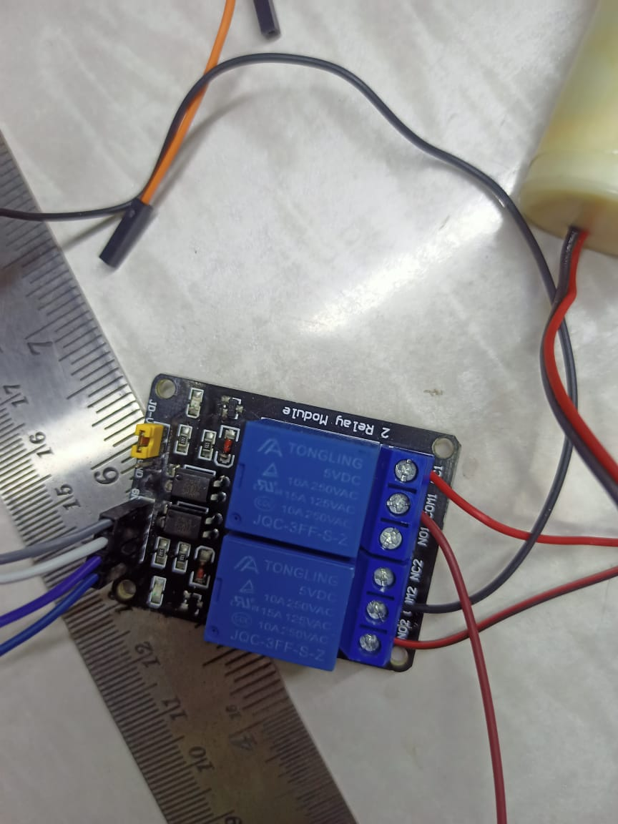
Soil moisture sensor + submersible water motor with relay

Slide 46
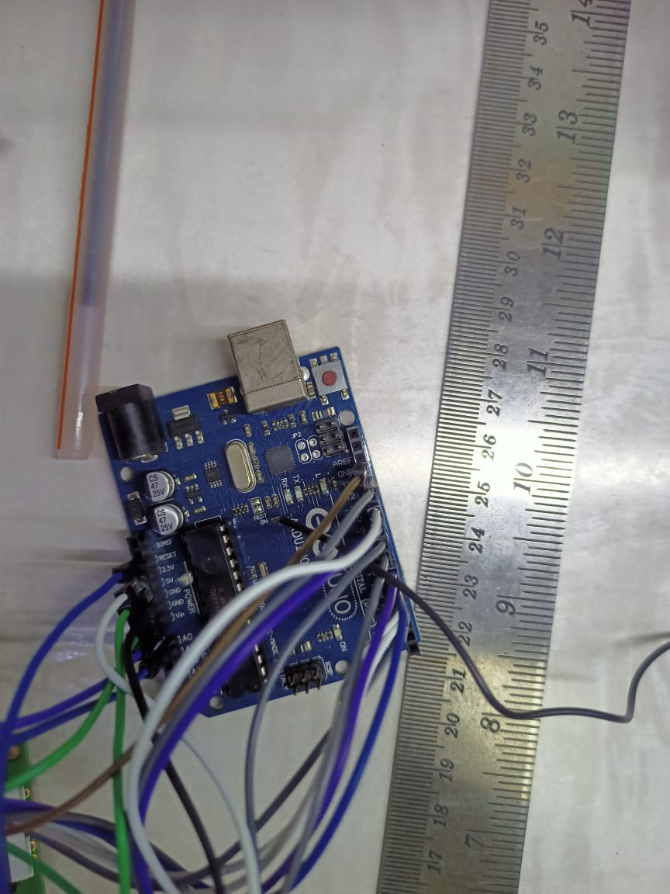
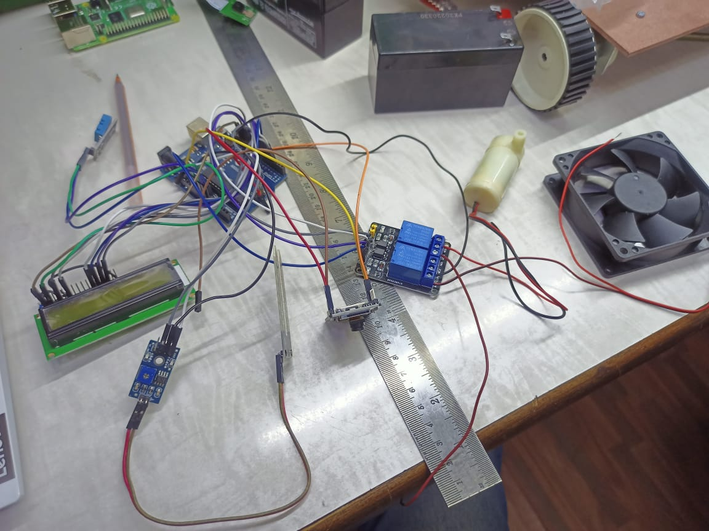
Arduino + assembly

Slide 47
Code
#include "DHT.h"
#include <LiquidCrystal.h>
//int IRSensor = 9; // connect ir sensor module to Arduino pin 9
#define Relay 6
#define sensorPin 9
int LED = 13; // conect LED to Arduino pin 13
LiquidCrystal lcd(3, 4, 5, 6, 7, 8);
#define DHTPIN A0 // what pin we're connected to
// Uncomment whatever type you're using!
#define DHTTYPE DHT11 // DHT 11
//#define DHTTYPE DHT22 // DHT 22 (AM2302)
//#define DHTTYPE DHT21 // DHT 21 (AM2301)
// Initialize DHT sensor for normal 16mhz Arduino
DHT dht(DHTPIN, DHTTYPE);

Slide 48
void setup() {
Serial.begin(9600);
// pinMode(IRSensor, INPUT); // IR Sensor pin INPUT
pinMode(sensorPin, INPUT);
pinMode(LED, OUTPUT); // LED Pin Output
Serial.println("DHTxx test!");
lcd.begin(16, 2);
dht.begin();
lcd.print("Plant Health");
delay(2000);
lcd.clear();
}
void loop() {
Soil();
// Wait a few seconds between measurements.
delay(2000);
// Reading temperature or humidity takes about 250 milliseconds!
// Sensor readings may also be up to 2 seconds 'old' (its a very slow sensor)
float h = dht.readHumidity();
// Read temperature as Celsius
float t = dht.readTemperature();
// Read temperature as Fahrenheit
float f = dht.readTemperature(true);

Slide 49
// Check if any reads failed and exit early (to try again).
if (isnan(h) || isnan(t) || isnan(f)) {
Serial.println("Failed to read from DHT sensor!");
return;
}
// Compute heat index
// Must send in temp in Fahrenheit!
float hi = dht.computeHeatIndex(f, h);
lcd.print("Temperature:");
lcd.print(t);// display the temperature
lcd.print((char)223);
lcd.setCursor(0, 1);
lcd.print("humidity:");
lcd.print(h); // display the humidity
delay(1000);
lcd.clear();
Serial.print("Humidity:");
Serial.print(h);
Serial.print(" %\t");
Serial.print("Temperature:");
Serial.print(t);
Serial.print(" *C ");
Serial.print(f);
Serial.print(" *F\t");
Serial.print("Heat index: ");
Serial.print(hi);
Serial.println(" *F");
}

Slide 50
void Soil()
{
int sensorStatus = digitalRead(sensorPin); // Set the GPIO as Input
Serial.print(sensorStatus);
if (sensorStatus == 1) // Check if the pin high or not
{
digitalWrite(Relay, LOW); // LED LOW
Serial.println("Motion Ended!"); // print Motion Detected! on the serial monitor window
}
else
{
//else turn on the onboard LED
digitalWrite(Relay, HIGH); // LED High
Serial.println("Motion Detected!"); // print Motion Ended! on the serial monitor window
}
}

Slide 51
Possible Outcomes
Technology is making giant strides, meaning that farmers who get ahead of the curve and invest now, can start to become more efficient, produce healthier crops and increase their margins.
Agricultural robots automate slow, repetitive, and dull tasks for farmers, allowing them to focus more on improving overall production yields, which will be vital as the world's population increases.
Farm automation practices can make agriculture more profitable while also reducing the ecological footprint of farming at the same time.
Site-specific application software can reduce the amount of pesticides and fertilizer used while also reducing greenhouse gas emissions.

Slide 52
Advantages
Reduces labor cost
Reduces human intervention.
Minimum time consumption
Higher plant growth rates.
Less failures crops.
Saves much water considering atmosphere sepal value .

Slide 53
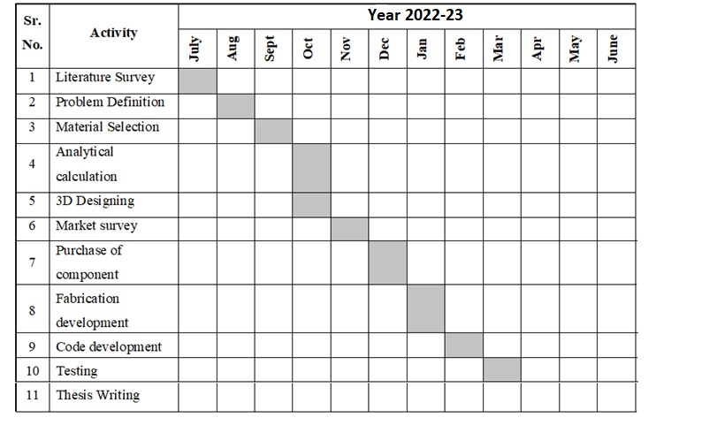
Proposed Plan of action

Slide 54
References
[1] AndrewEnglish, Patrick Ross, David Ball, “Vision Based Guidance for Robot Navigation in Agriculture, Member, IEEE, Peter Corke, Fellow,IEEE-2014
[2] Chung L. Chang “Zigbee-assisted Mobile Robot Gardener”, Senior Member, IEEE,andJia H. Jhu IEEE - 2013
[3] XinLiu, Qian Zhang*, RuPeng Luan, Feng Yu Applications of Perceptual HashAlgorithm in Agriculture Images, 2013 IEEE.
[4] ” XUE Jinlin, XULiming “Autonomous Agricultural Robot and ItsRowGuidance ” IEEE 2010.
[5] Sanjay B. Patilet al “Leaf Disease Severity MeasurementUsing Image Processing” / International Journal of Engineering and Technology Vol.3 (5), 297- 301 2011
[6] SajjadYaghoubi, Negar Ali Akbarzadeh, ShadiSadeghiBazargani“Autonomous Robots for AgriculturalTasks and Farm Assignment and FutureTrends in Agro Robots”, International Journal of Mechanical &MechatronicsEngineering IJMME-IJENSjune2013.
[7] Pedersen S. M,Fountas S and Blackmore S “Agricultural Robots – Applications and Economic Perspective”, University of Copenhagen,Institute of Food and Resource Economics.
[8] ” liming wang, Jianboshi, Gang song and I-fan shen“Object detection combining recognitionand segmentation”, Fudanuniversity shanghai

